Slide 1
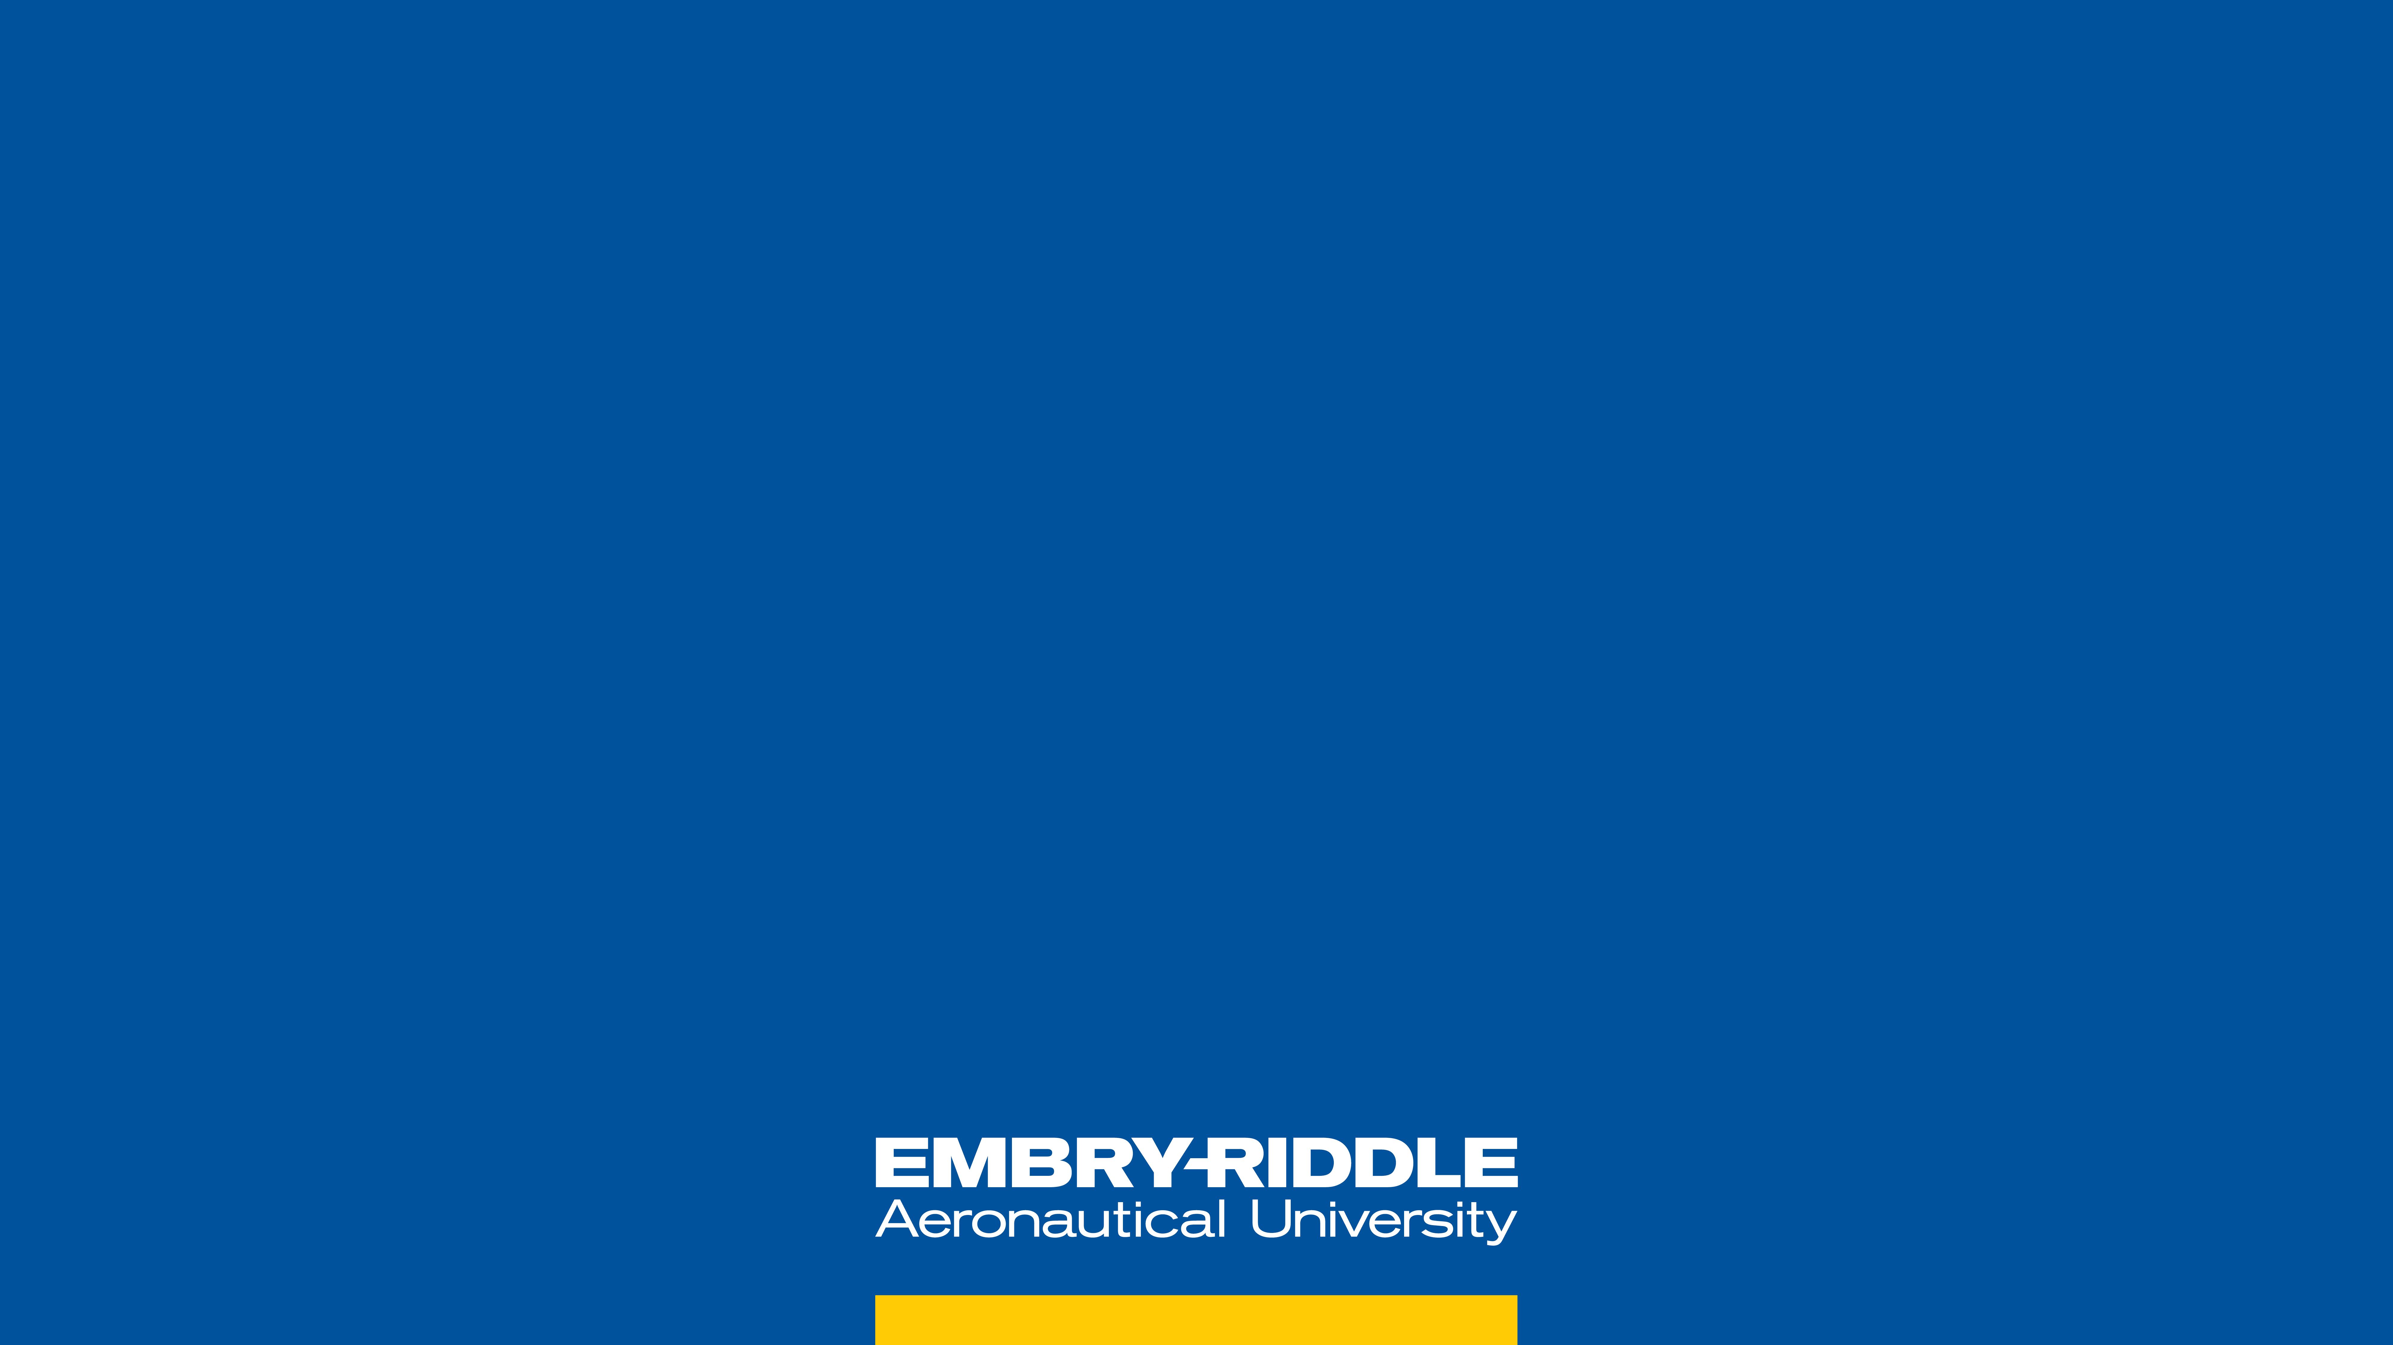


BIREFRINGENCE TESTING ON AlGaAs MIRRORS Ambroise Juston, Aerospace Engineering Ari Chai, Space Physics Mentors: Dr. Andri Gretarsson, Department of Physics Dr. Ellie Gretarsson, Department of Physics and Aerospace Engineering
PHYSICS / ENGINEERING

Slide 2
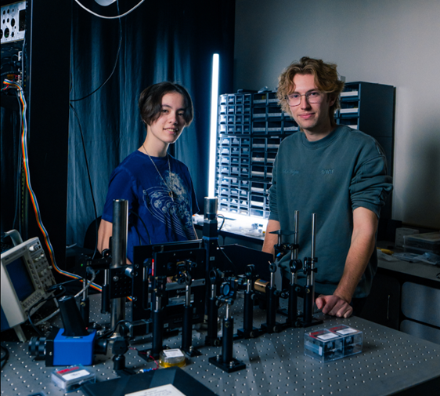
ABSTRACT
Birefringence testing On AlGaAs Mirrors
We propose a combined approach to test birefringence in Aluminum Gallium Arsenide (AlGaAs) mirrors with a 1064 nm laser:
This project reconstructs an optical chain to analyze the birefringent behavior of the mirror material under infrared lasers.
Furthermore, we introduce a separate optical setup that includes a laser cavity featuring a vibrating mirror to examine the resonance peaks of the laser light within the cavity, offering two high-definition experimental platforms to measure birefringence.
This investigation will deepen understanding of AlGaAs's optical properties and enhance the design of mirrors for laser systems, critical in Laser Interferometer Gravitational Observatories.

Slide 3
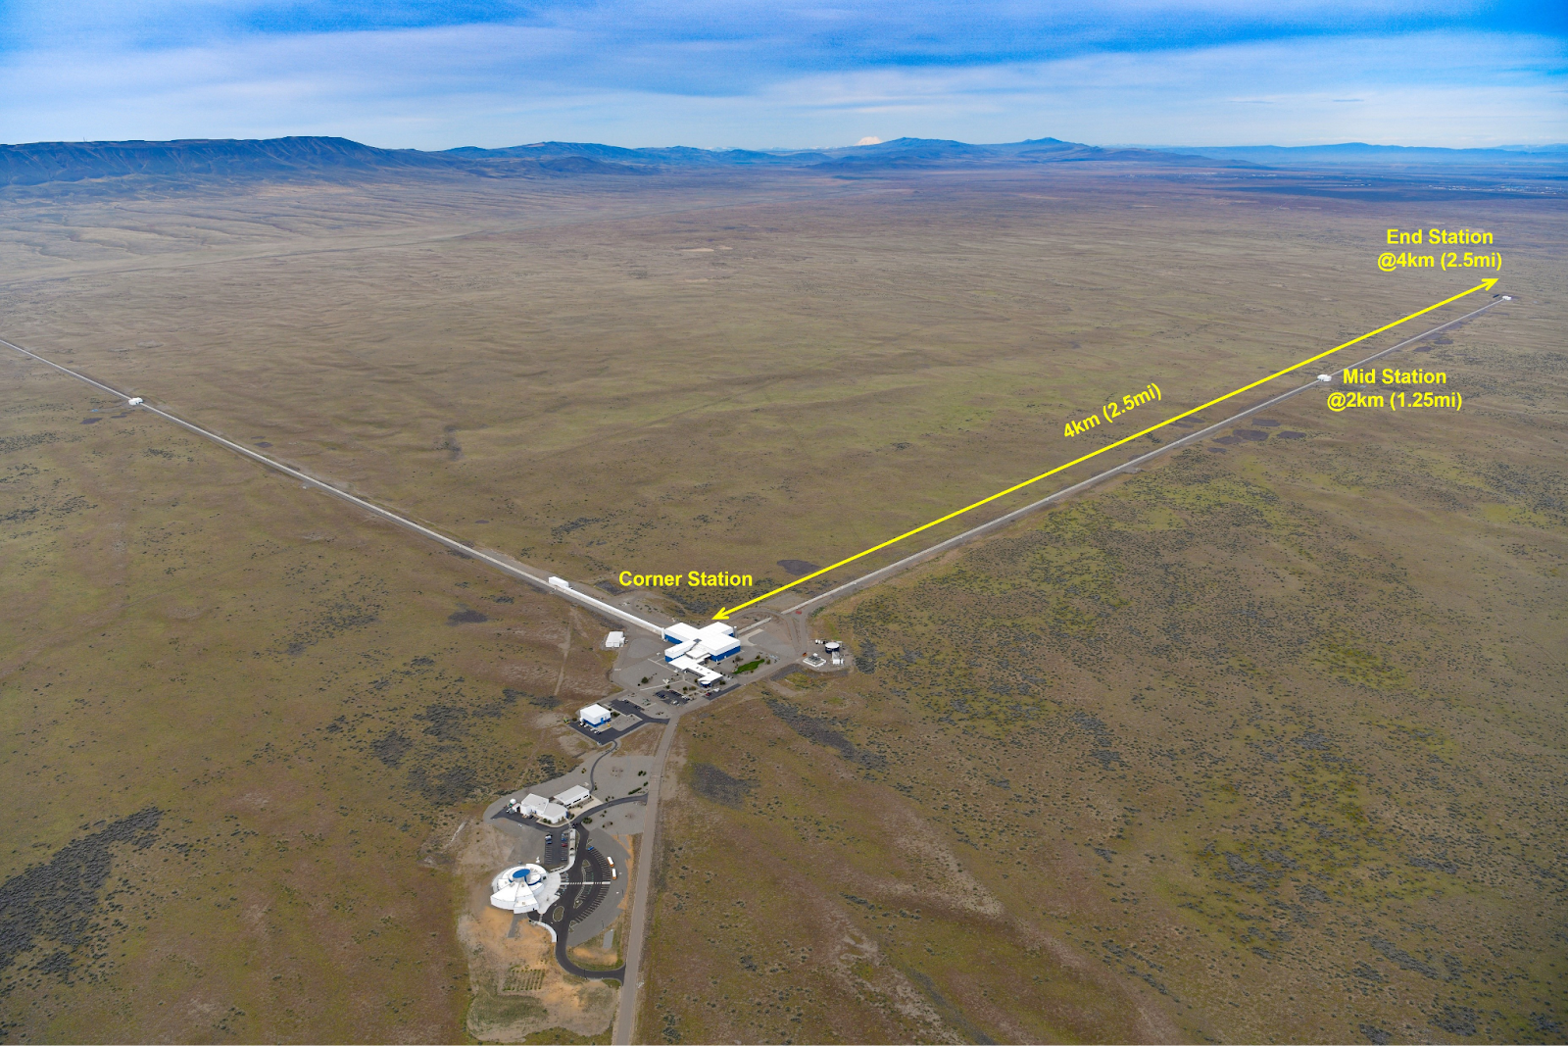
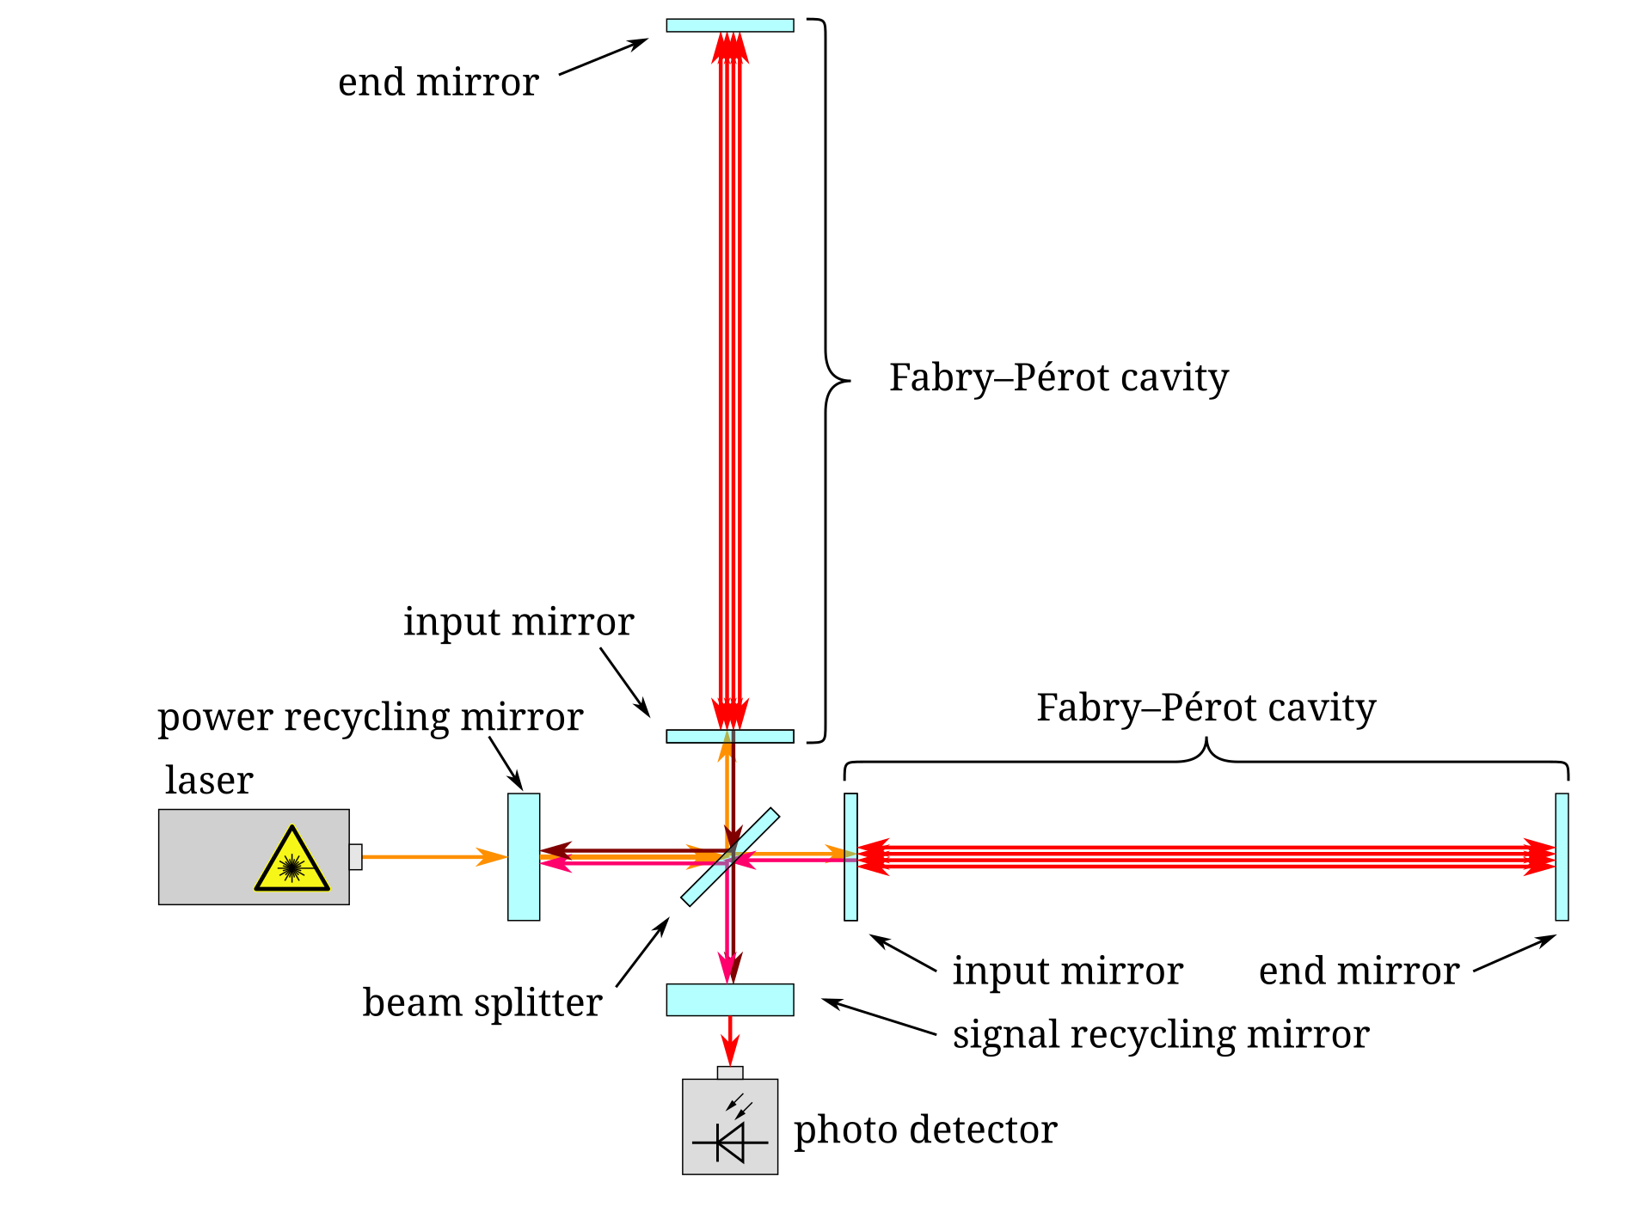
What is LIGO?
BACKGROUND
https://www.ligo.caltech.edu/page/ligo-detectors
https://simple.wikipedia.org/wiki/LIGO#/media/File:LIGO_simplified.svg

Slide 4
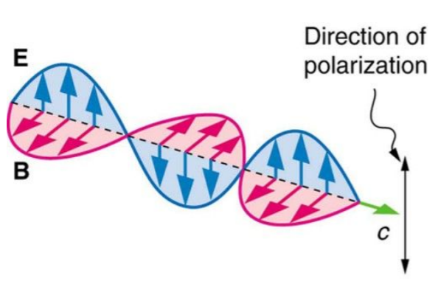
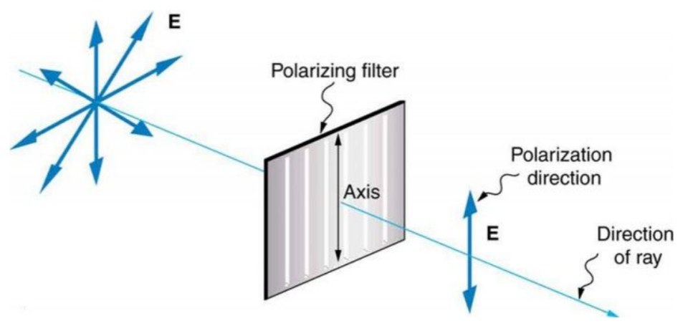
What is birefringence and why do we care?
BACKGROUND
Birefringence: an optical property where light splits into two rays upon entering an anisotropic material, causing different refractive indices for different polarizations
https://www.collegesidekick.com/study-guides/physics/27-8-polarization

Slide 5

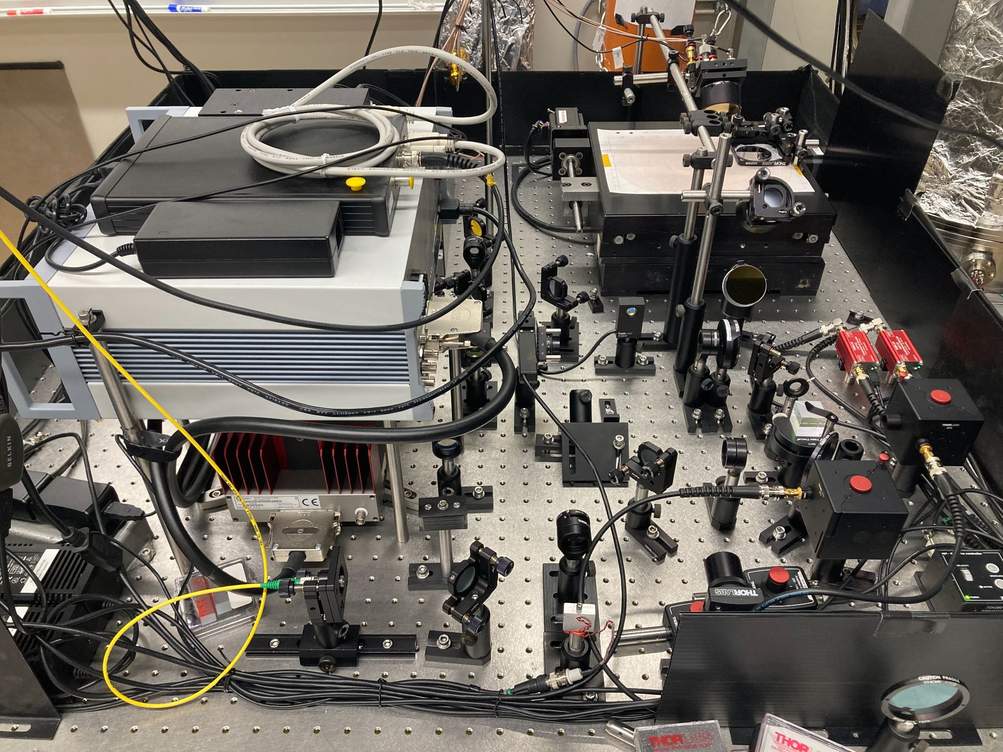
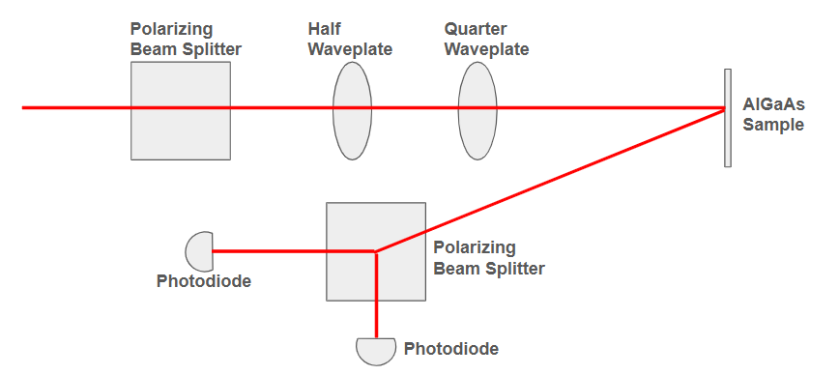
What are we doing?
PROJECT DESCRIPTION
Goal: to replicate the results of Dr. Gretarsson’s experiment and determine why the data does not fit our current models.

Slide 6
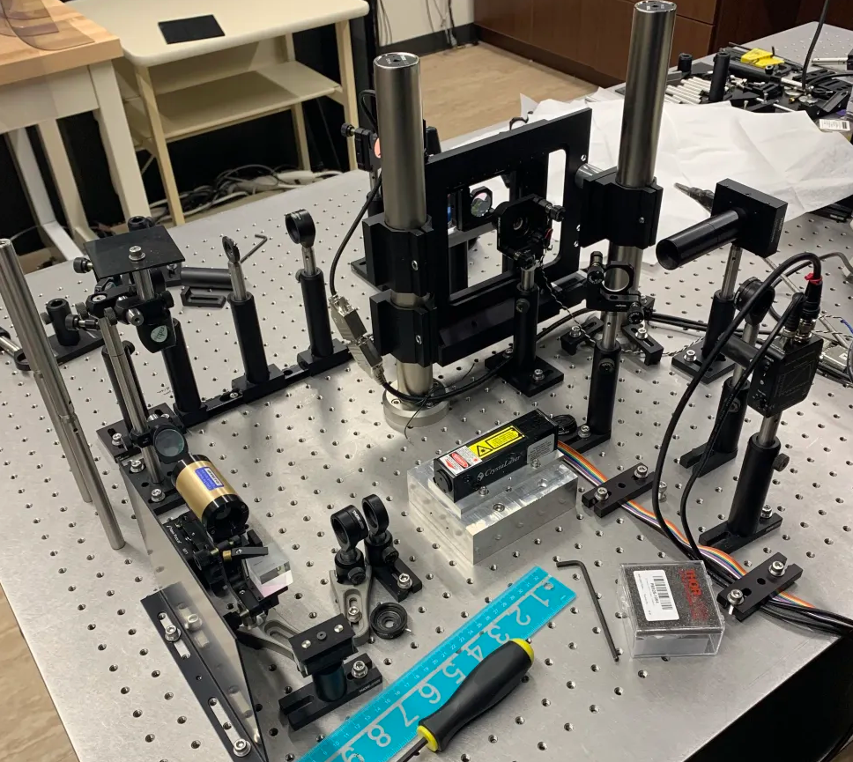
What else are we working on?
PROJECT DESCRIPTION
Goal: to model the transient effects of non-steady laser cavities
Goal: to set up a new experimental setup to measure the birefringence from frequency splitting

Slide 7
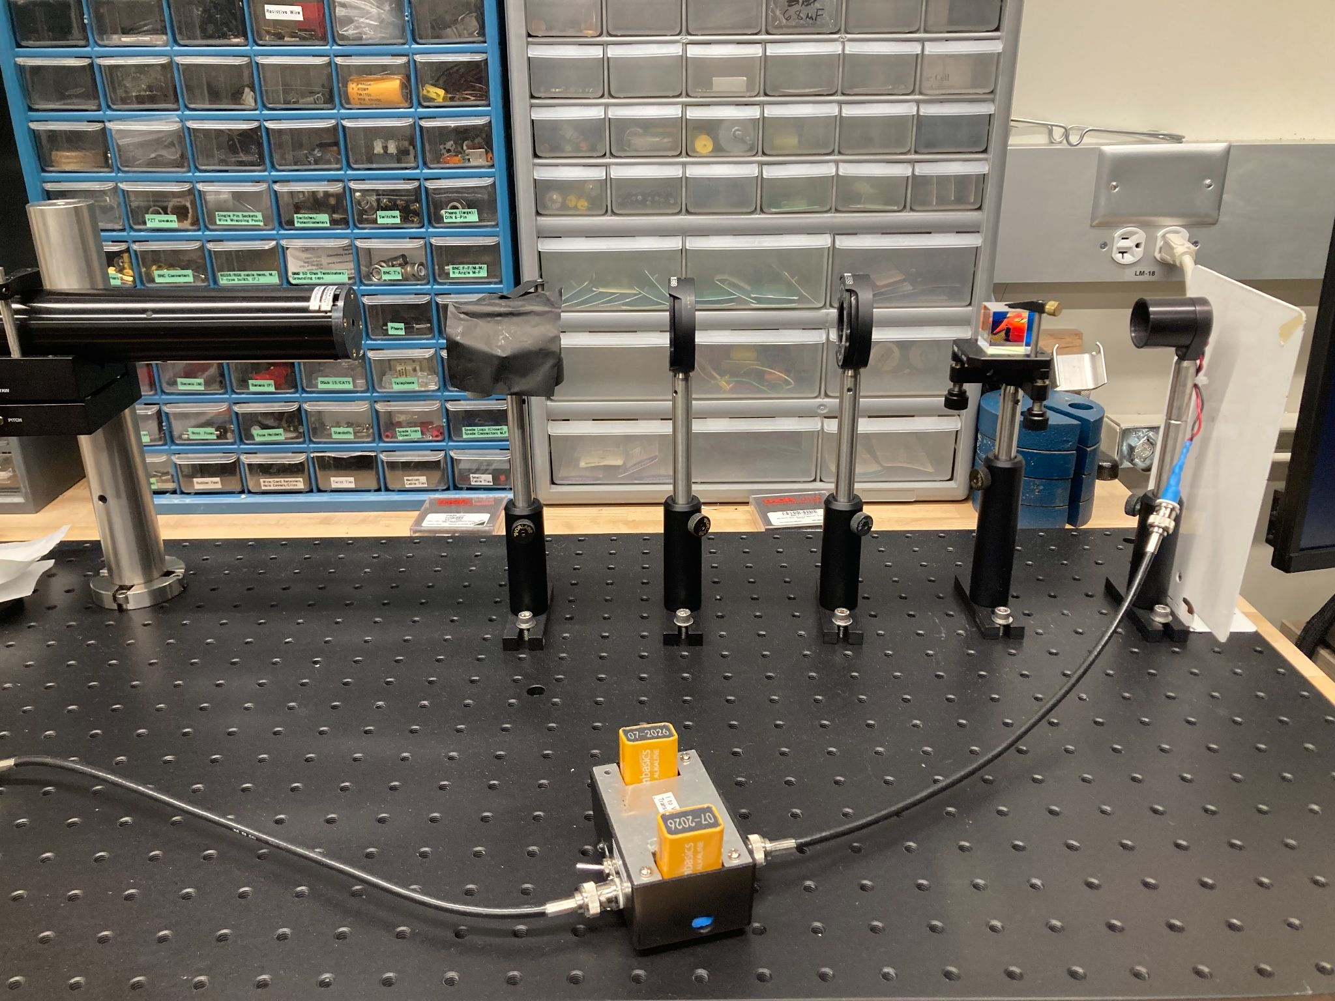
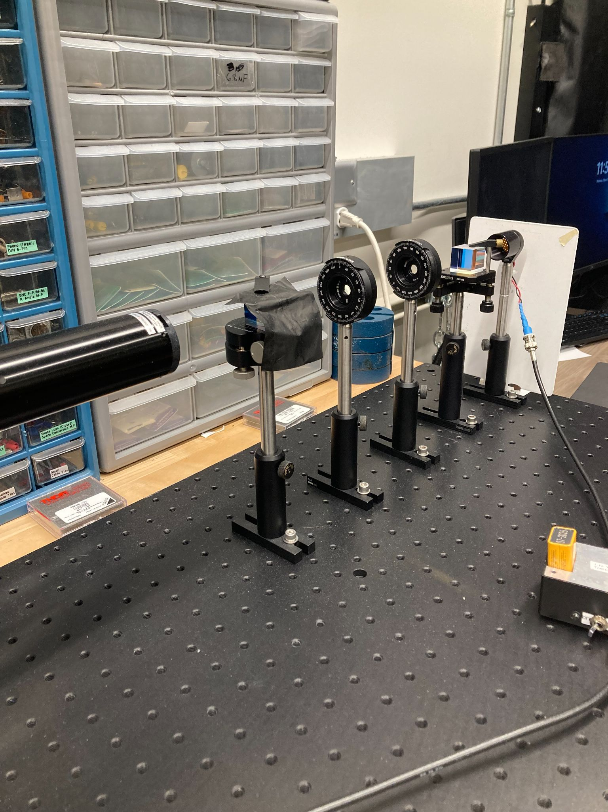
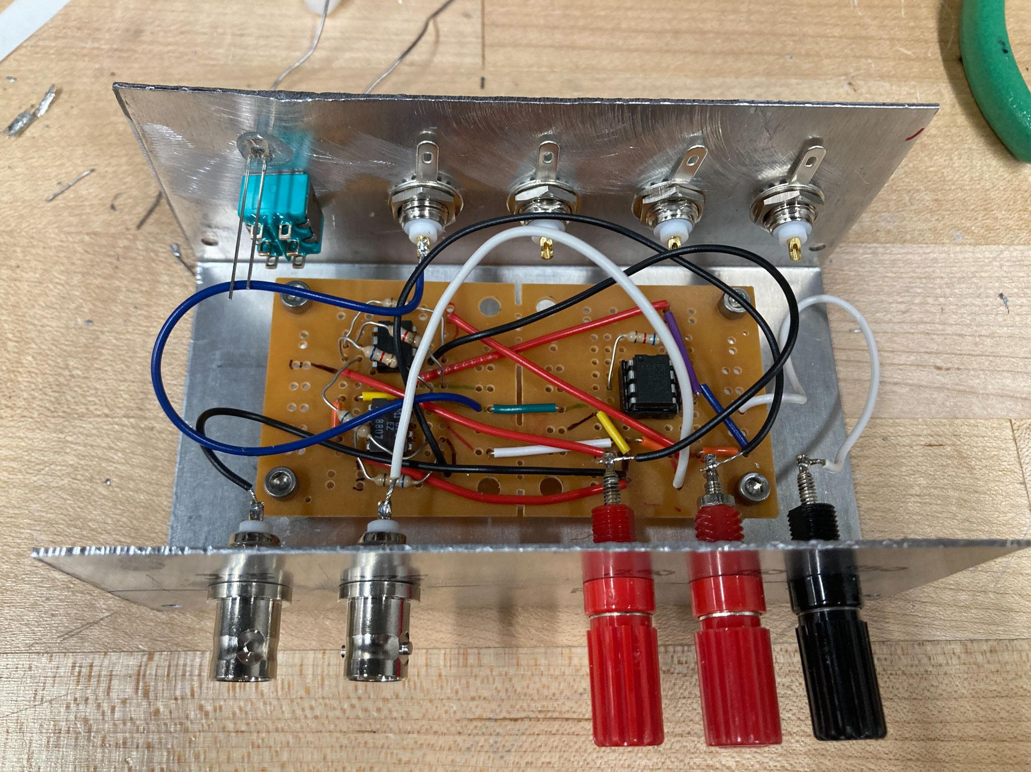
How far are we?
PROGRESS

Slide 8
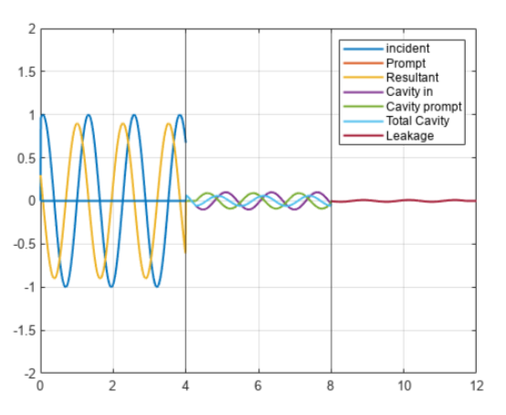
How far are we?
PROGRESS

Slide 9
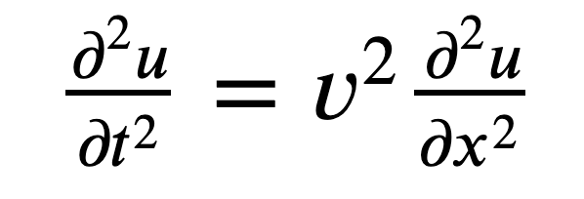
What comes next?
FUTURE PLANS

